Slide 1
Under the Guidance of Ms. H. KAVIETHA M.E Department of Computer Science and Engineering Sri Sai Ram Institute of Technology, Chennai, Tamil Nadu, India
INTEGRATING SUPPLY CHAIN MANAGEMENT TO CATER FOR DEMAND AND SUPPLY IN SMALL SCALE INDUSTRIES
By
KARTHICK M 412419104049
SYEDABUTHAHIR A 412419104136
TARUN H 412417104137

Slide 2
OVERVIEW
Objective
Abstract
Demand forecasting using sales prediction
Advantages of demand forecasting
Existing system and its limitation
Proposed solution for demand forecasting
Advantage of the proposed solution
System and Hardware Requirements
Literature Survey
Architectural Design of the system
Flow Diagram of the application
Sample Screenshot of the model comparisons
SDG Goal
References

Slide 3
OBJECTIVE
Improving the financial planning of the system which lays out necessary steps to generate future income and cover future expenses.
SCM has a direct impact on the quality of a company’s products as well as its overall profitability.
Optimizing business expenses by establishing an optimized supply chain
Customer satisfaction through exceptional service, transparency, and visibility that your customers demand.
Enable the organization to estimate the future quantity and quality of people required for material production.
Sales strategy which is faced by retailers can be done using proper pricing policy

Slide 4
ABSTRACT
Building an efficient demand management system
Improving the organization’s standard by meeting the customer needs by maintaining the required inventory.
Predicting the demand by forecasting the sales using the sales pattern in order to efficiently meet customer demand.
Implementing appropriate machine learning techniques to predict the future sales of an organization.
To create a model that will perform train test split, scale the data, reverse scaling, create a prediction data frame, and score the models.
This solution also uses the ARIMA model for time series forecasting that will use the SARIMAX model and generate a dynamic prediction.

Slide 5
EXISTING SYSTEM AND IT’S LIMITATIONS
existing system and its limitations
Excessive Regulation
Obsolete technology
Limited R&D support
Lack of capital and financial resources for investing in a new technology
lack of trust, investing a principle amount for a software that guarantees increased productivity and efficency sounds to good to be true for an industry that has worked entirely of physical bills and log books
Low skill mix of the labor / work forcex Rising competition due to imported products putting local buisnesses out of play

Slide 6
PROPOSED SYSTEM
Implementing different machine learning techniques and comparing different models for datasets passed as the input.
Enabling risk-adjusted forecasting solutions for the problem.
Using the time series prediction algorithm (Auto Regressive Integrated Moving Average) model for better forecasting.
Implementing a novel data-driven weighted moving average machine learning model in the forecast systems for predicting future demand in risk-adjusted ways.
The same technique will be implemented for automating the order placement system in the production unit.
Integrating an efficient forecasting model which meets customer demand will increase an organization’s profit.

Slide 7
ADVANTAGES OF PROPOSED SYSTEM
Demand planning and forecasting.
Full transparency among the industries and sub production units
Tagging sensors and geolocation technologies (IoT)
Computerized inventory control.
A possible future implementation of blockchain for security and transaction purposes

Slide 8
REQUIREMENTS
4.1 SOFTWARE REQUIREMENTS
OPERATING SYSTEM – Windows 7 or Higher
APPLICATION SOFTWARE – Beta analytics
4.2 HARDWARE REQUIREMENTS
PROCESSOR : Intel(R)core(TM)i5-2410M CPU@2.30GHz
SPEED :2.30 GHz
OPERATING SYSTEM : 64-bit operating system
RAM :4 GB RAM

Slide 9
LITERATURE SURVEY
SL NO | TITLE OF THE PAPER | TECHNOLOGY | JOURNAL NAME | YEAR
1 | Customer Order Behavior Classification via Convolutional Neural Network in the semi conductor industry. | Machine Learning | IEEE TRANSACTIONS ON SEMICONDUCTOR MANUFACTURING, VOL. 35, NO. 3, AUGUST 2022 | 2022
2 | A Novel Dynamic Demand Forecasting Model for Resilient Supply Chains using Machine Learning | Machine Learning | 2021 IEEE 45th Annual Computers, Software and Applications Conference (COMPSAC) | 2021
3 | Machine Learning Model for Sales Forecasting by using XGBoost | Machine Learning | 2021 IEEE International Conference on Consumer Electronics and Computer Engineering (ICCECE 2021) | 2021

Slide 10
LITERATURE SURVEY
SL NO | TITLE OF THE PAPER | TECHNOLOGY | JOURNAL NAME | YEAR
4 | Sales Prediction based on Machine Learning. | Machine Learning | 2021 2nd International Conference on E-Commerce and Internet Technology (ECIT). | 2021
5 | Sales Forecasting for Supply Chain demand management – A Fuzzy time series approach | Machine Learning | 2019 13th International Conference on Mathematics, Actuarial Science, Computer Science, and Statistics. | 2019
6 | Sales Forecasting of Retail Stores using Machine Learning Techniques. | Machine Learning | 3rd IEEE International Conference on Computational Systems and Information Technology for Sustainable Solutions 2018 | 2018

Slide 11
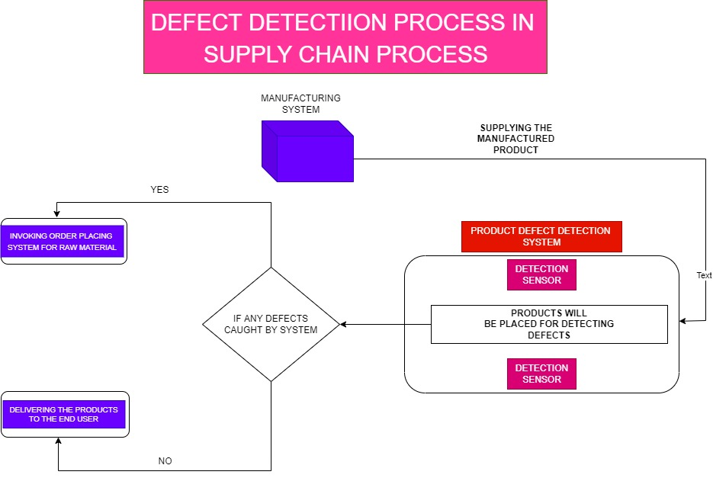
ARCHITECTURAL DIAGRAM

Slide 12
FLOW DIAGRAM

Slide 13
MODULES
Two modules
subscriber end
publisher end

Slide 14
MODULE’S DESCRIPTION
SUBSCRIBER
SUBSCRIBER END: subscriber end is the assembly end module that receives the raw material from production facility it indicates the quantity of non defective products produced with the supplied raw materials publisher end
PUBLISHER END
publisher end : the publisher end is the production facilities's software that takes count as soon as production starts it keeps count of total units produced quantity of good units quantity of defective units it can send a mail with these parameters to the administrator after every shift automatically or manually

Slide 17
CONCLUSION & FUTURE ENHANCEMENTS
The goal of supply chain management is value creation and a company creates value by offering products or services to its customers by managing
processes (delivering a product from raw materials to the consumer), managing resources (e.g. information, assets, products) and managing
capabilities (e.g. the people who work within the supply chain) in sustainable (where there are embedded value for customers),
energy efficient (due to corporate social responsibilities) and profitable (the goal of every for-profit entity) ways.
Supply chain management is an important part for every organization as it improves the effectiveness, efficiency, management of resources, etc.
it also establish god and prominent relations with the stake holders like suppliers, customers, etc. it integrates and combines the entire business activities and take care of each and every step that ultimately helps in achieving satisfaction of the customers and goals of the company.
By implementing SCM in small scale industries that are not exposed to the tech we aim to bring the proportional level of advantages that scm offers to current large scale industries to small scale enterprises

Slide 18
SDG GOAL
Decent work and economic growth
- since the demand is already known the workforce can either be laid off or put to overtime only when required.
Industry, Innovation, and infrastructure
- Increase the access of small-scale industrial and other enterprises, particularly in developing countries aiding financial growth, including affordable credit, and their integration into value chains and markets.
Responsible consumption and production
- since we only procure as many raw materials as we require for production, the wastage is significantly reduced.

Slide 19
REFERENCES
1.S. Khan, F. Khan and B. Zhang, "Supply Chain Management for SMEs in Pakistan," 2010 International Conference on E-Business and E-Government, 2010, pp. 3443-3446, doi: 10.1109/ICEE.2010.865.
2. M. Ding, J. Xiao and H. Li, "Research on Cooperation of the Small and Medium Enterprise Clusters Based on Supply Chain Management," 2009 International Conference on Management and Service Science, 2009, pp. 1-4, doi: 10.1109/ICMSS.2009.5302191.
3. K. Mahadevan, P. Samaranayake and K. Matawie, "Supply chain integration, information sharing and supply chain visibility-the remedy for supply chain uncertainty in australian organisations," 2010 8th International Conference on Supply Chain Management and Information, 2010, pp. 1-9.
4. Y. Palmo, S. Tanimoto, H. Sato and A. Kanai, "IoT Reliability Improvement Method for Secure Supply Chain Management," 2021 IEEE 10th Global Conference on Consumer Electronics (GCCE), 2021, pp. 364-365, doi: 10.1109/GCCE53005.2021.9622088.

Slide 20
REFERENCES
5. H. A. Kuo, T. Ponsignon, H. Ehm and C. F. Chien, "Overall Supply Chain Effectiveness (OSCE) for Demand and Capacity Incorporation in Semiconductor Supply Chain Industry," 2019 IEEE International Conference on Smart Manufacturing, Industrial & Logistics Engineering (SMILE), 2019, pp. 24-28, doi: 10.1109/SMILE45626.2019.8965314.
6. S. Kang and T. Moon, "Supply Chain Integration and Collaboration for Improving Supply Chain Performance: A Dynamic Capability Theory Perspective," 2016 49th Hawaii International Conference on System Sciences (HICSS), 2016, pp. 307-316, doi: 10.1109/HICSS.2016.45.

Slide 21
THANK YOU

